Slide 1
Lecture 5 – Support Vector Machines

Slide 2
TO DO: Intuition

Slide 3
TO DO: Dot product

Slide 4
TO DO: Margin
SVM is called a ‘large margin classifier’ as it tries to maximize the margin between the positive and negative support vectors

Slide 5
Linear SVM – Representation

Slide 6
Linear SVMs Mathematically (cont.)
Sec. 15.1
Then we can formulate the quadratic optimization problem:
A better formulation (min ||w|| = max 1/ ||w|| ):
Find w and b such that
is maximized; and for all {(x_{i} , y_{i})}
w . x_{i} + b ≥ 1 if y_{i}=1; w . x_{i} + b ≤ -1 if y_{i} = -1
Find w and b such that
Φ(w) =½ |w | ² is minimized;
and for all {(x_{i} ,y_{i})}: y_{i} (w . x_{i} + b) ≥ 1

Slide 7
Dataset with noise
denotes +1
denotes -1
Hard Margin: So far we require all data points be classified correctly
- No training error
What if the training set is noisy?
- Solution 1: use very powerful kernels
OVERFITTING!

Slide 8
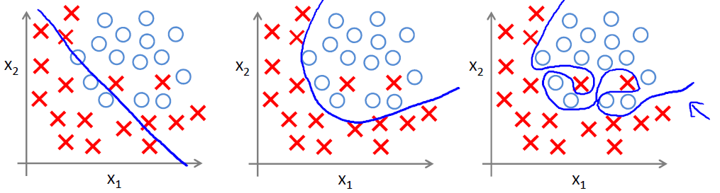
Underfitting
Overfitting

Slide 9
Soft Margin Classification
Slack variables ξi can be added to allow misclassification of difficult or noisy examples.
What should our quadratic optimization criterion be?
Minimize
ε₁₁
ε₂
wx+b=1
ε₇
wx+b=0
wx+b=-1

Slide 10
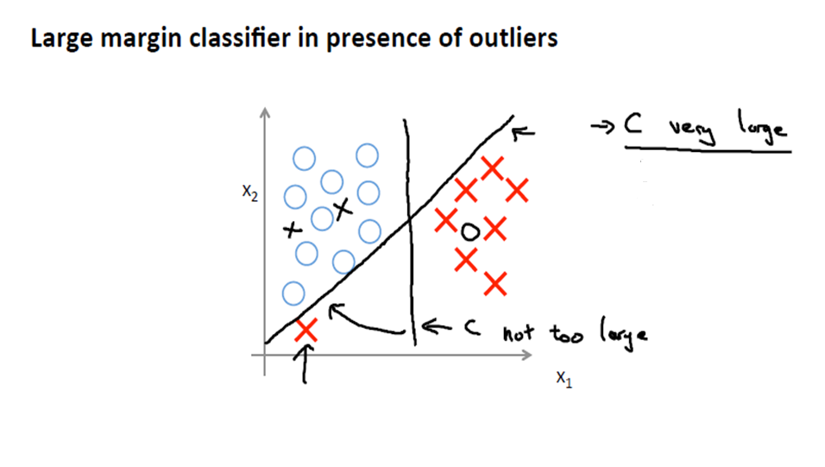

Slide 11
Hard Margin v.s. Soft Margin
The old formulation:
The new formulation incorporating slack variables:
Parameter C can be viewed as a way to control underfitting/overfitting – Regularization parameter
Find w and b such that
Φ(w) =½ |w|² is minimized and for all {(x_{i} ,y_{i})}
y_{i} (w . x_{i} + b) ≥ 1
Find w and b such that
Φ(w) = ½ |w|² + CΣξ_{i} is minimized and for all {(x_{i} ,y_{i})}
y_{i} (w . x_{i} + b) ≥ 1- ξ_{i} and ξ_{i} ≥ 0 for all i

Slide 12
Soft Margin Classification – Solution
Sec. 15.2.1
The dual problem for soft margin classification:
Find α₁…α_{N} such that
Q(α) =½ |w|² - Σα_{i} [y_{i} (w . x_{i} + b) -1] is maximized
∂ (Q)/ ∂ (w) = 0 => w = Σα_{i}y_{i}x_{i}
∂ (Q)/ ∂ (b) = 0 => Σα_{i}y_{i} = 0

Slide 13
Linear SVMs: Summary
Sec. 15.2.1
The classifier is a separating hyperplane.
The most “important” training points are the support vectors; they define the hyperplane.
Quadratic optimization algorithms can identify which training points x_{i} are support vectors with non-zero Lagrangian multipliers α_{i}.
Both in the dual formulation of the problem and in the solution, training points appear only inside inner products:
f(x) = Σα_{i}y_{i}x_{i} . u + b

Slide 14
Classification with SVMs
Sec. 15.1
Given a new point u, we can score its projection onto the hyperplane normal:
I.e., compute score: w . u + b = Σα_{i}y_{i}x_{i} .u + b
Decide class based on whether < or > 1
Can set confidence threshold 1.
Score > 1 yes
Score < -1 no
Else: don’t know
1
0
-1

Slide 15
Non-linear SVMs
Datasets that are linearly separable with some noise work out great:
But what are we going to do if the dataset is just too hard?
How about… mapping data to a higher-dimensional space:
0
x
0
x
x²
0
x

Slide 16
Non-linear SVMs: Feature spaces
General idea: the original input space can always be mapped to some higher-dimensional feature space where the training set is separable:
Φ: x → φ(x)

Slide 17
The “Kernel Trick”
The linear classifier relies on dot product between vectors K(x_{i},x_{j})=x_{i} .x_{j}
If every data point is mapped into high-dimensional space via some transformation Φ: x → φ(x), the dot product becomes:
K(x_{i},x_{j})= φ(x_{i}) . φ(x_{j})
A kernel function is some function that corresponds to an inner product in some expanded feature space.

Slide 18
Kernel function
Example:
2-dimensional vectors x=[x₁ x₂]; let K(x_{i},x_{j})=(1 + x_{i} . x_{j})²,
Need to show that K(x_{i},x_{j})= φ(x_{i}) . φ(x_{j})
Mercer’s theorem

Slide 19
Kernels
Sec. 15.2.3
Why use kernels?
Make non-separable problem separable.
Map data into better representational space

Slide 20
Examples of Kernel Functions
Linear: K(x_{i},x_{j})= x_{i} . x_{j}
Polynomial of power p: K(x_{i},x_{j})= (1+ x_{i} . x_{j})^{p}
Gaussian (radial-basis function network):
Sigmoid: K(x_{i},x_{j})= tanh(β₀x_{i} . x_{j} + β₁)
String
chi Square

Slide 21
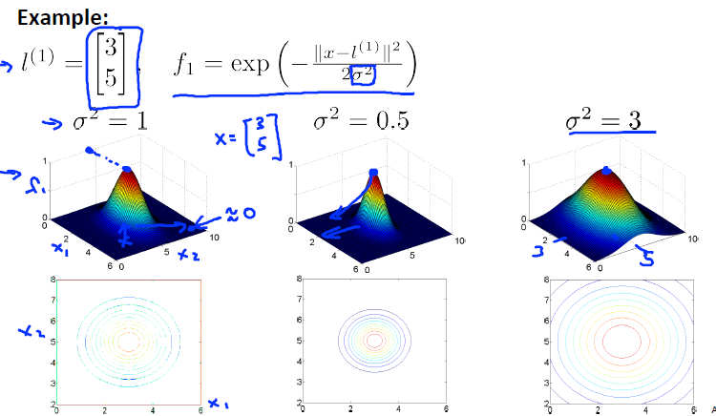

Slide 22
TO DO: Classification using Kernel methods

Slide 23
SVM Parameters
C – higher C – Lower bias/High Variance
- Overfitting
C – smaller C – High bias/Low Variance
- Underfitting
σ² – Large- f varies smoothly – Higher bias/Low variance
- Underfitting
σ² – Small - f varies sharply – Lower bias/High variance
- Overfitting
Note: C has the opposite behavior to λ in linear/logistic regression

Slide 24
Properties of SVM
Non-parameterized model (Parameterized vs non-parameterized)
Overfitting can be controlled by soft margin approach
Nice math property: a simple convex optimization problem which is guaranteed to converge to a single global solution
Ability to use kernel functions to separate non linearly separable classes
Can work with large no. of features

Slide 25
Some Issues
Choice of kernel
- Gaussian or polynomial kernel is default
- if ineffective, more elaborate kernels are needed
- domain experts can give assistance in formulating appropriate similarity measures
Choice of kernel parameters
- e.g. σ in Gaussian kernel
- σ is the distance between closest points with different classifications
- In the absence of reliable criteria, applications rely on the use of a validation set or cross-validation to set such parameters.
Optimization criterion – Hard margin v.s. Soft margin
- a lengthy series of experiments in which various parameters are tested

Slide 26
SVM Applications
SVM has been used successfully in many real-world problems
- text (and hypertext) categorization
- image classification
- bioinformatics (Protein classification,
Cancer classification)
- hand-written character recognition
Could work well even when your training set is relatively small

Slide 27
Multi-class classification
One-vs-All
Built into many libraries

Slide 28
SVR (support vector regression)
Using the same idea for regression
The optimization function now tries to fit the support vectors, instead of trying to maximize the margin between positive and negative support vectors

